Slide 1

A
Project presentation
on
Manufacturing Analytics Dashboard
By
VARDHAN AMBATI
SHAIK ARSHAD
NEHA GUPTA
AGHAV SHITAL
TANGALLAPALLY SAI
FALGUNI KHARE
VATTEM ASHISH
.

Slide 2
CONTENTS
INTRODUCTION
KPIs
Excel Dashboard
Tableau Dashboard
Power BI Dashboard
SQL
Key Insights
Conclusion

Slide 3
INTRODUCTION
The main aim of this project track daily and monthly production identify high downtime machines analyze defect rate improve overall production efficiency.
This project is based on manufacturing production data analysis.
The dataset contains information about machines, production quantity, defects, downtime, and cost.
The data is analyzed using Excel, SQL, and Power BI , Tableau.
A dashboard is created to monitor performance and identify problem

Slide 4
KPIs Used in This Project
In this project, we selected KPIs like Total Production, Defect Rate, Machine Utilization, Downtime, and Production Cost. These KPIs help to measure performance, quality, and efficiency in the manufacturing process.
Total Production
Measures total number of units produced.
Defect Rate (%)
Shows percentage of defective products.
Machine Utilization (%)
Measures how effectively machines are used
Total Downtime
Total cost involved in production process.

Slide 5
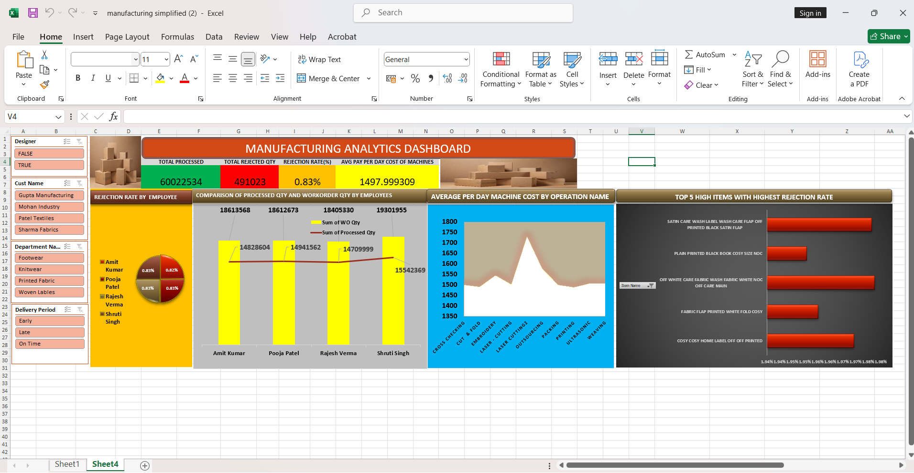
Excel Dashboard

Slide 6
Excel Dashboard
This Dashboard shows the Excel-based Manufacturing Dashboard created for this project.
The dashboard provides a complete overview of production performance in a single screen.
It includes important KPIs such as Total Production, Defect Rate, Machine Utilization, Downtime, and Production Cost.
Different charts like bar chart, line chart, and pie chart are used to visualize machine-wise production, monthly trends, and shift-wise performance.
Interactive filters are added to easily analyze data by month, machine, or shift.
This dashboard helps management to quickly understand performance and take better decisions.
.

Slide 7
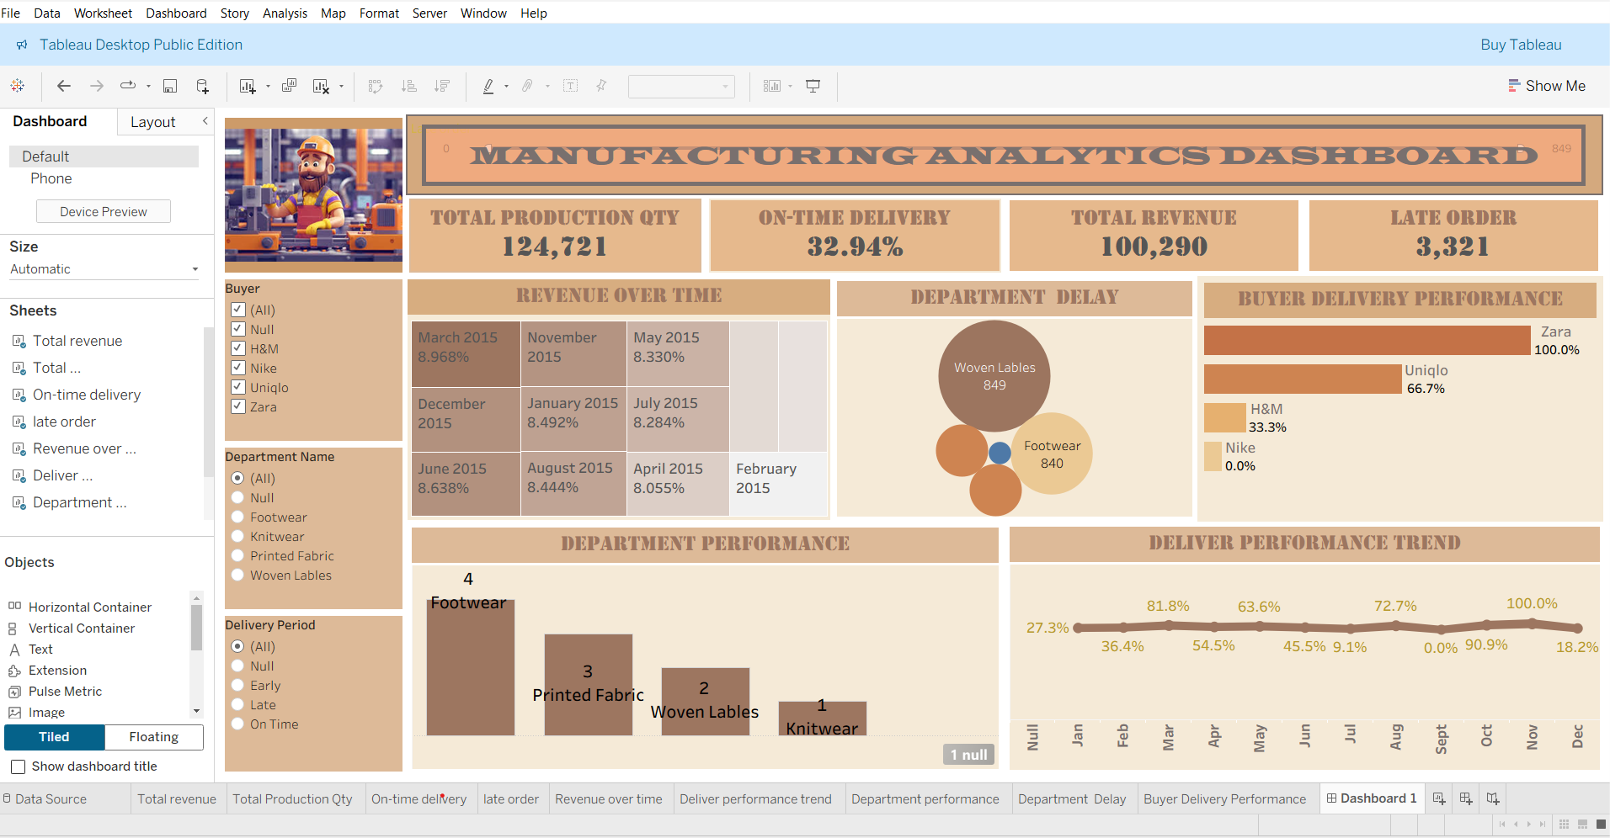
Tableau Dashboard

Slide 8
Tableau Dashboard
This dashboard provides an overall view of manufacturing performance.
It displays key KPIs such as Total Production Quantity, Revenue, On-Time Delivery, and Late Orders.
The KPI section gives a quick summary of business performance. Interactive filters allow users to analyze data by buyer, department, and delivery period
.The revenue heatmap shows monthly performance trends. The department delay chart highlights areas causing delivery issues.
Buyer delivery performance compares efficiency across different buyers. Department performance chart ranks departments based on output.
The delivery trend line shows monthly fluctuations in performance.
Overall, the dashboard helps management make data-driven decisions to improve efficiency and profitability.

Slide 9
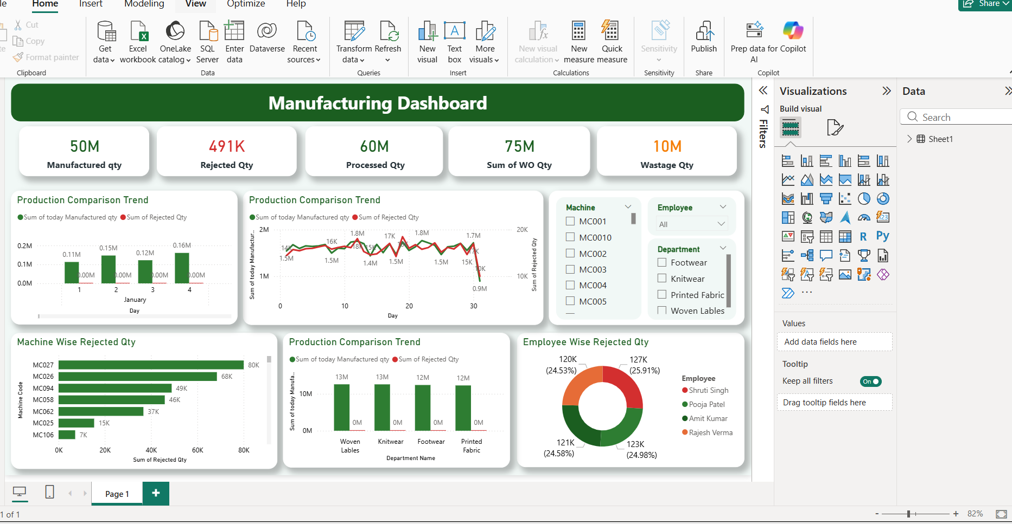
Power BI Dashboard

Slide 10
Power BI Dashboard
This dashboard provides a comprehensive overview of manufacturing operations using Power BI.
The top KPI cards display key metrics such as Manufactured Quantity, Rejected Quantity, Processed Quantity, Work Order Quantity, and Wastage Quantity.
These KPIs give a quick summary of overall production performance. The Production Comparison Trend charts show the comparison between manufactured and rejected quantities over time.
The Machine-wise Rejected Quantity chart highlights which machines contribute most to rejections. The Department-wise production comparison helps evaluate performance across different departments.
The Employee-wise Rejected Quantity chart identifies employees associated with higher rejection rates. Interactive filters for Machine, Employee, and Department allow dynamic data analysis.
Trend analysis helps identify production patterns and operational inefficiencies. Overall, this dashboard supports data-driven decision-making to improve productivity and reduce wastage.

Slide 11
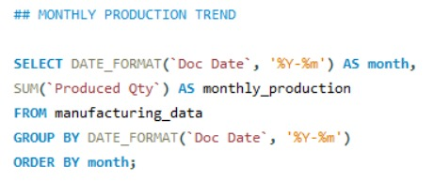
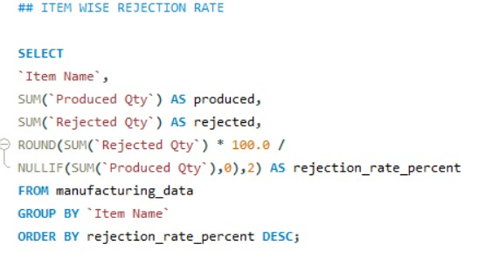
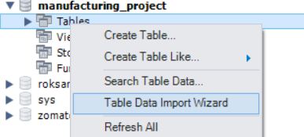
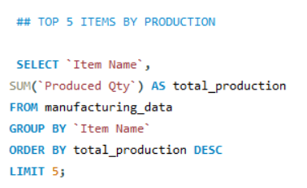
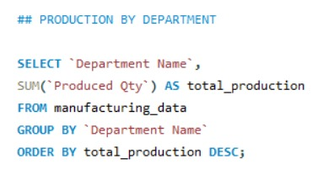
SQL
.

Slide 12
Key Insights
Rejected quantity is high and needs quality improvement.
Department performance varies across units.
Wastage impacts overall productivity and cost.
Production trends show operational fluctuations.

Slide 13
Conclusion
This dashboard provides a clear overview of manufacturing performance.
It helps identify rejection, wastage, and efficiency issues.
The insights support data-driven decision making.
Regular monitoring can improve productivity and reduce operational loss.

Slide 14
Thank You

